Slide 1
Envision: Life Like Any Other Enhancing community collaboration
ICDD Council Retreat 2016
Donna Ennis, Lieke van Heumen, Chih-Chieh Hsu, Ana Zalka & Jerome Gill
Supported by an Investment of the Illinois Council on Developmental Disabilities

Slide 2
Agenda
Overview
Photo voice
Preliminary findings
Posters
Next steps

Slide 3
Overview

Slide 4
Our process (I)
Envision worked with residents of 4 CILA homes
Goal to have 15 participants actively engaged with new community organizations
Collaboration with UIC-DHD
Conducted training on Asset-Based Community Development
Completed community mapping of specific Chicago areas
Notes:
5 minutes

Slide 5
Our process (II)
Completed interest assessments with participants
Created resumes to help clarify participants’ interests and skills
Provided participants individual supports to find community organizations
Incorporated photo voice to capture perspectives of participants with IDD

Slide 6
Outcomes
15 participants regularly participate in community groups with natural supports
As of 8/31/16, 9 additional individuals from other CILAs are participating in community groups
Job description for future graduate students who serve as community collaborators
Participants became new members of Envision for Freedom self advocacy group

Slide 7
Lessons learned
Churches are powerful allies
Training of staff on how to support community inclusion is needed in provider organizations
Internet access required to assist participants identify community opportunities
Travel training or paratransit needed to sustain community involvement

Slide 8
Photo voice

Slide 9
Background
We wanted to retrieve the experiences of people with IDD with their community activities
Accommodations needed to effectively include people with IDD in research
Photo voice used as an accessible strategy to engage people with IDD
Inclusive research is a learning process for all
Co-create new knowledge
Notes:
5 minutes

Slide 10
Photo voice
Uses photography to access other people’s experiences
Offers voice and gains perspectives of people with IDD on their own lives
Interesting and enjoyable method for people with IDD

Slide 11
Our steps
Approval Institutional Review Board UIC
Consent process
First group meeting
Introduction and training on camera use
Four weeks of taking photos with multiple moments of individual support by research team
Individual interviews
Final group meeting
Group discussion and preparation of posters
Data analysis

Slide 12
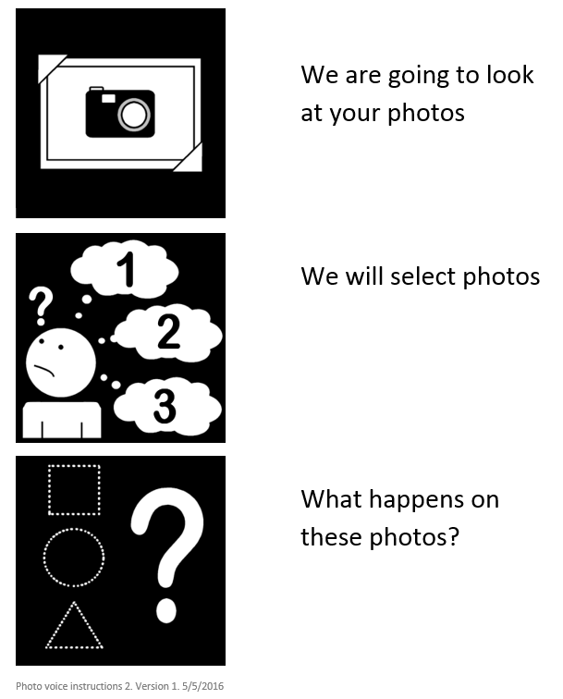
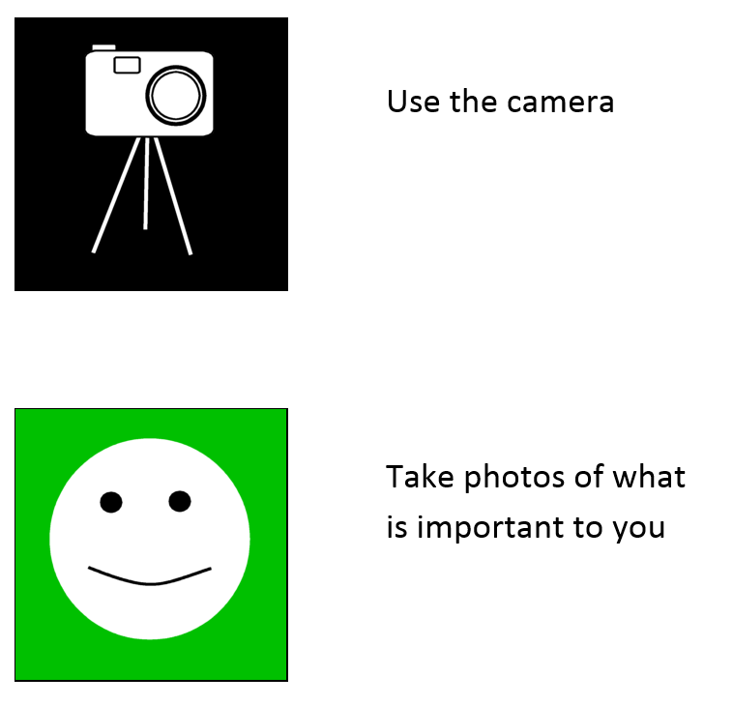
Accessible materials

Slide 13
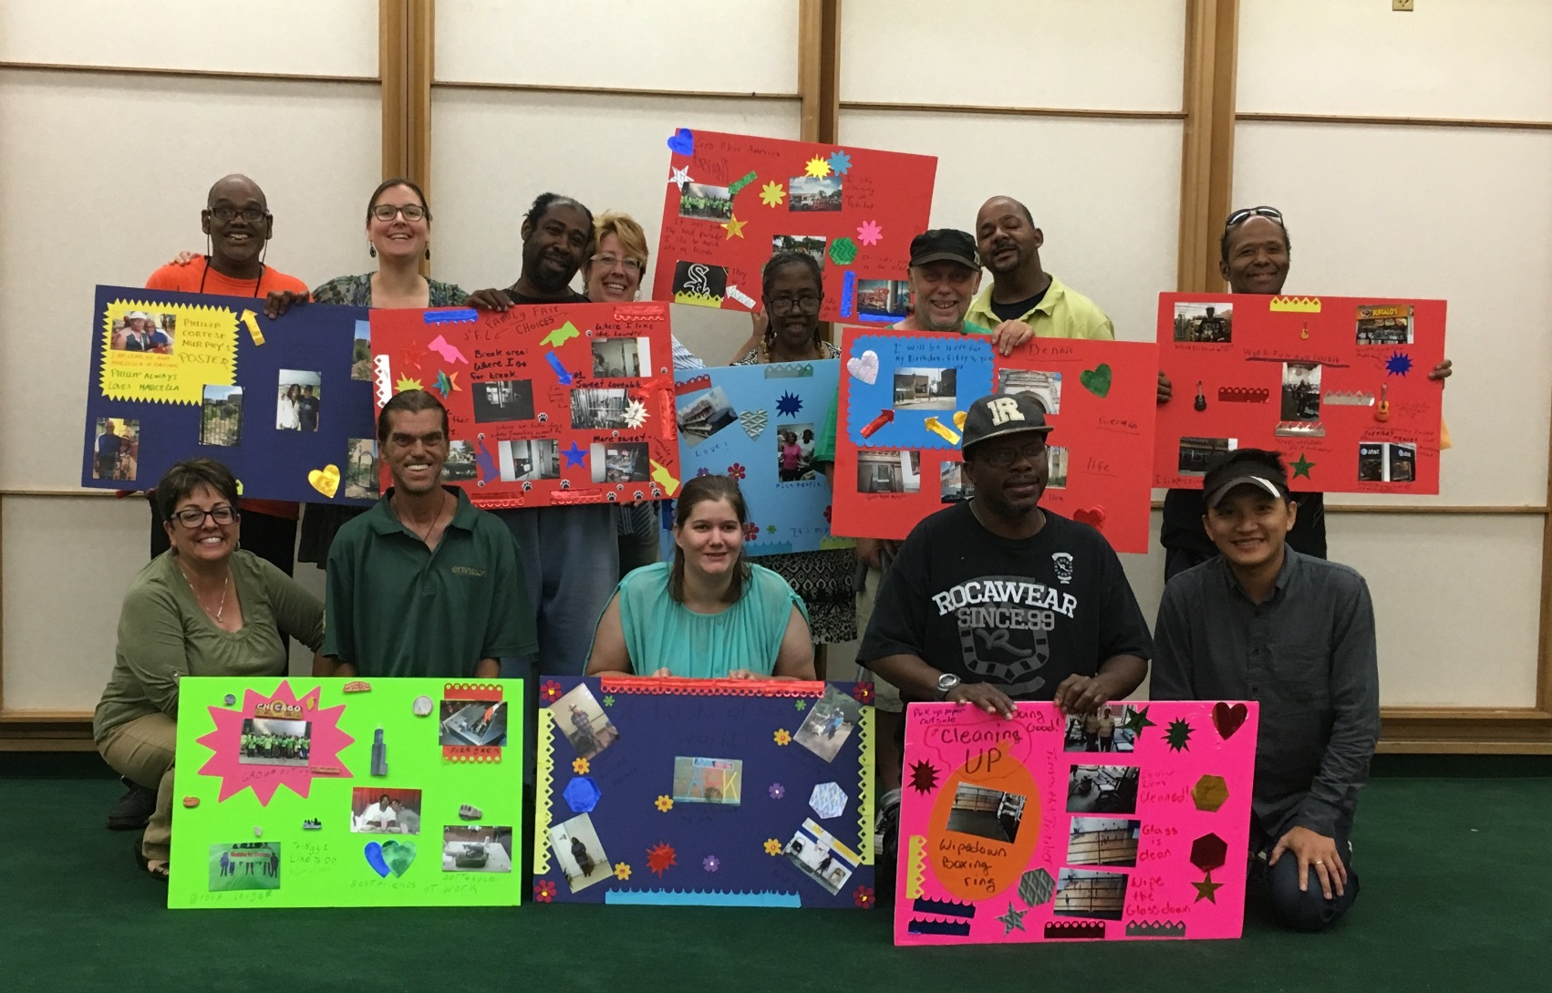
We did it!

Slide 14
Preliminary findings

Slide 15
Preliminary themes
Engagement in desired community activities provided building blocks for:
meaningful engagement
new skills
self-esteem
social connections
continued personal growth and learning

Slide 16
Quotes
“I am just glad that I made some friends…. I learned how to get along with people, how to talk to people and respond to people…I'm proud of it.” (F, 55 )
“I am making new friends there [volunteer activity]. He [colleague] makes me laugh. He keeps me busy… If I wasn’t here [volunteer activity], everyone would miss me… I have learned how to pull weed and work with the dirt... My next step was I wanted to learn how to work with a tool.” (M, 49)
“It [volunteer activity] gets me to know more people…I am volunteering…. for me to learn something more within the future that I can see, that I can do better…. So far I've learned how to take apart computers real good. That was one thing I've never done.” (M, 52)

Slide 17
Posters

Slide 18
Next steps

Slide 19
Next steps
Share a document with the lessons we learned
Improve staff training regarding supporting community participation
Participants of photo voice project will work with Illinois Self-Advocacy Alliance for Change to develop a webinar
Publish and present the results of the photo voice evaluation in local and national outlets

Slide 20
Questions

