Slide 1
Heroes of the Game, Inc. Possibility of People
Life Like Any Other Grant
Illinois Council on Developmental Disabilities

Slide 2
What does Heroes of the Game believe is work worth doing?
We are a small organization dedicated to the people we support in living a life that is comfortable, proud, completely connected and grounded in their community. We support people to do as much as possible for themselves. We support their participation to a degree that they can participate, raising the bar, never stagnant, learning all the time.
We presume competence and an interest in belonging. We work with the people who know the person really well and ask them what they think we should know. We work with support people to use and develop their gifts to help the person supported in bridging them to the beloved community.

Slide 3
Quality of Life Outcomes How do we help the person learn valued social roles, make a contribution, and expand and deepen his or her relationships?

Slide 4
What We Believe (and act on)
Everyone has a gift
Everyone wants to share their gifts
There is a place that needs that gift
- Beth Mount, “Beautiful Justice”
(Our job is to connect all of these!)

Slide 5
Some Valued Social Roles
Family Member
Friend
Neighbor
Citizen
Athlete
Partner
Home owner
Worker
Learner
Artist

Slide 6
Five Valued Experiences – John O’brien
Belonging – in a variety of relationships and memberships.
Choosing – what they want in everyday situation in ways that reflect their highest purpose. Having the freedom, support, information and assistance to make the same choices as others of a similar age and learning to make wiser choices over time. Being encouraged to use and strengthen voice regardless of the mode of communication, clarify what really matters, make thoughtful decisions and learn from experience.
Contributing - by discovering, developing and giving their gifts and investing their capacities and energy in pursuits that make a positive difference to other people. There are gifts of being and gifts of doing: Contributions can include interested presence as well as capable performance. Contributions may be freely exchanged or earn pay.
Sharing Ordinary Places – with other citizens: living, working, learning and playing confidential in ordinary community settings.
Being Respected – as whole persons whose history, capacities and futures are worthy of attention and whose gifts engage them in valued social roles.

Slide 7
On Finding the Sweet Places in Community:
Where people come together by consent
Rather than control;
Where relationships are based on affiliation and shared interest
Rather than exchange;
Where people are always identifying, inviting and mobilizing one another’s gifts;
Where the culture expresses itself in the form of stories
Rather than data;
Where we hear people singing because people are making music,
Rather than consuming music;
Where people are making art,
Rather than consuming art.
- John McKnight

Slide 8
Possibility of People – an Organic Process
Discovery
Networks
Appreciative Inquiry
Accompaniment
Person Centered Planning – Seeing and Seeking Capacity
Yours, Mine, Trust Networks
How We know them
Learning Labs
Potlucks
Other learning events

Slide 9
Possibility of People – an Organic Process
Asset Mapping
Following the Threads
Inventory of Community
Informational Interviews
Ideal Conditions of Employment
Ideal Conditions of Community (participation)
Employer needs analysis
Support analysis

Slide 10
Following the “threads” of interest
Themes, clubs, personal networks, finding the “enthusiasts”
Possible themes: Art, music, social justice, nature, farming, food, health, transportation, pets, theater, fabric textile, woodworking
Possibly Clubs: Art, Beliefs, Technology, Pets, Education, Games, Language, Books and Writing, Social, Career/Business, Sports, Fitness, Dancing, Outdoors, Food, Music

Slide 11
Support Needed?
Ideal Conditions of Employment or Community
Time, Size, Input, Difficulty, Participation, Level of Support, Output.
Socialization, Routine, Structure, Breaks, Movement, Sound/Quiet, Lighting

Slide 12
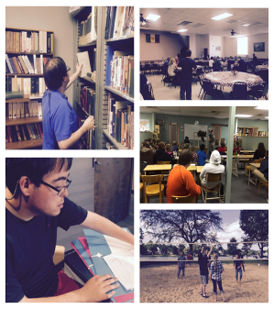
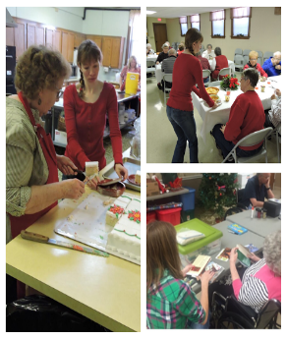
A Few Stories
Derek
Kristen
Notes:
Impact – Derek broadened his horizons and met a few friends. People know him and care about him.
Kristen feels important and valued and connected. Her family is happy that she feels connected. The folks at the nursing home benefit from having an engaging energetic support person with them.

Slide 13
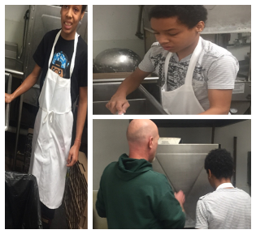
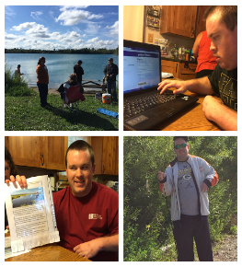
A Few Stories
Cameron
Jordan
Notes:
Cameron is learning about making money and budgeting his money.
Jordan has learned public speaking skills in addition to offering a much needed club to the community.

Slide 14
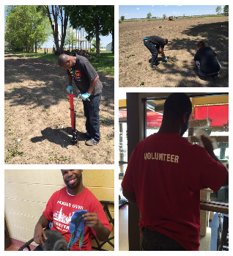
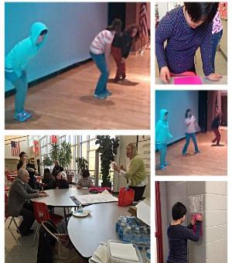
A Few Stories
Gavin
Odalys
Notes:
Gavin is making his own money and enjoys being outdoors and the health benefits from working on a farm. He is also teaching his mom, who has a backyard garden, about farming.
Odalys is able to share her love of music and dancing with her high school, and leaders and students are benefitting from a new club and learning that leadership can sometimes come from unexpected places. Odayls family is proud that Odalys has a place of possibility. The superintendent is proud to be offering a club outside of athletics to the high school. Gabby, the college student from the local college is able to share her dancing experience and learn new teaching, engagement skills with high school students.

Slide 15
What We Have Learned About our Partners
The world they envision has been shaped over many years before they met us.
We’re trying to offer a little bit of a new version to replace that old memory – the one that may have taken a wrong turn.
We know this isn’t like flipping a switch. It’s more like opening up a flower.
Through accompaniment, encouragement and resilience, we have been able to help open up gifts – as well as building on the gifts already opened.
People need to trust. Trust comes from relationships. Relationships come over time, from quality experiences.

Slide 16
“What a good life means to me”

Slide 17
Sharing a little about what a good life means:
“I just want a group of friends to get together with on the weekends”
- Emily
“Being a man means making money and paying my own bills”
- Matt
“I want to work with Bob (at the ice cream shop) he’s awesome – yeah!”
- Gage
“I am sharing my love of God through my music”
- Kayla

Slide 18
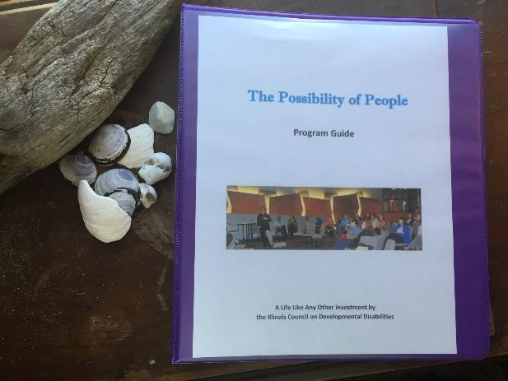
Want to learn more?
Take a look at our Program Guide

Slide 19
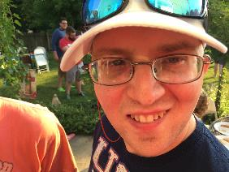
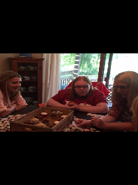
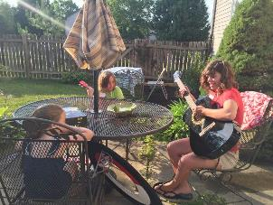
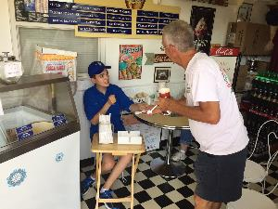
This year…..
Parish
Kayla
Katie
Gage
Notes:
Katie – crying at school – now she’s happy to go and happy when she comes home; She’s made over 400 cupcakes since she started her business and was on the local news;
Parish is telling his staff what he wants – and it’s being OUT IN THE COMMUNITY – he is a non-skating support member of the Barbed Wire Betties Roller Derby; looking at apartments to live in; working out at the YMCA
Kayla – playing with the church band and facilitating conversations with our potluck community;
Gage is working at a nursing home and the local ice cream shop;
Cruz recently joined a “Hacker”s computer club and asked his Dad to stay outside – he goes in on his own.

Slide 20
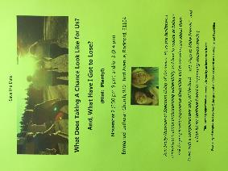
What’s Next?
Facilitated Conversations:
Learning Lab,
Potlucks/community conversations;
Shelley Nessman: “What Have We Got to Lose?”
Mentoring in DeKalb, Chicago, LaSalle
And Waterloo area

Slide 21
Our Program Guide has been requested
BY OVER 200 individuals and organizations!!!!

Slide 22
What would I like to see grow in my community?
I’d like to see a stronger cultural mindset around believing:
“We’re the people we’ve been waiting for”
“We’ve got to take the time to try things out”
“It’s worth the effort”
“Proud of who we are and be willing to take a few risks”

