Slide 1


Taking Care of Yourself During a Public Health Emergency
This project was supported, in part by grant numbers 19/2001ILSCDD-02, from the U.S. Administration for Community Living, Department of Health and Human Services, Washington, D.C. 20201. Grantees undertaking projects with government sponsorship are encouraged to express freely their findings and conclusions. Points of view or opinions do not, therefore, necessarily represent official ACL policy.

Slide 2
Think about your...
BODY
MIND
EMOTIONS
SUPPORT
Coping with a public health emergency can be stressful. You may have to deal with uncertanity, concerns about your health, the health of your family and friends, changes in your routine, limited access to your resources, and more. Thankfully there are steps you can take for yourself during this difficult time.

Slide 3
Taking Care of Your Body
Typical Care
Be physically active
Maintain a healthy diet
Keep routine sleep schedule
Relax with breathing exercises
Protect Yourself
Wash your hands
Avoid touching eyes, nose, mouth
Wear a mask
Social distance
Protect Others
Cover coughs and sneezes
Stay home when sick
Wear a mask
Social distance

Slide 4
Taking Care of Your Mind
Where do I start?
Engage in activities or hobbies you enjoy
Try as much as possible to maintain a daily routine
Meditate or rest your mind as a way to relax
Take breaks throughout the day

Slide 5
Taking Care of Your Emotions
Things to try...
Notice and accept how you feel, try not to judge your feelings
Treat yourself with compassion and understanding
Talk about your feelings with someone you trust
Use calming self-talk
“I can handle this”
“One day at a time”

Slide 6
Connect to Support
How can we do this?
Ask for help when needed from friends, family, or professionals
Reach out to others by…
Calling
Texting
Social Media
E-Mails

Slide 7
Staying Informed Without Stressing Out

Slide 8
While it’s important to stay up to date with the most current information regarding the public health emergency, you don’t want to overwhelm yourself with news that causes you to feel anxious.
So, what can you do?
Avoid
Excessive exposure to media coverage
Limit
Media exposure to a single credible source Check Information updates at a specific time, only once or twice per day Gather Information that allows you to take practical steps to protect yourself and loved ones

Slide 9
Coping Strategies
Breathe
Keep A Gratitude Journal
Create a Return to Community Safety Plan

Slide 10
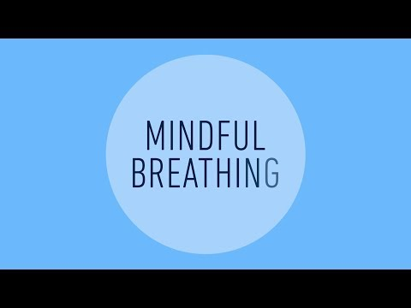

Slide 11
Keeping A Gratitude Journal
Remember that being grateful doesn’t mean there aren’t difficult and challenging things going on. It just helps us to remember there are also good things happening.
Write down 2-5 things for which you feel grateful. These things can be very small or very big. Think about something you enjoyed, someone with whom you interacted, an accomplishment, an obstacle you overcame, or other things. You don’t need to write in your journal everyday-just a few times a week is beneficial.
Be specific and include details of the event, experience, accomplishment, etc.
Try to focus on people more than things
Think about being grateful for negative things that didn’t happen or an obstacle you turned into an opportunity
Write down things you didn’t expect or suprised you

Slide 12


Slide 13

Questions?
Contact us:
EP!C 1913 W. Townline Road Peoria, IL 61615
Phone: 309.205.5503
https://epicci.org

